Slide 1

“Application For Grocery Delivery”
Task - 1

Slide 2
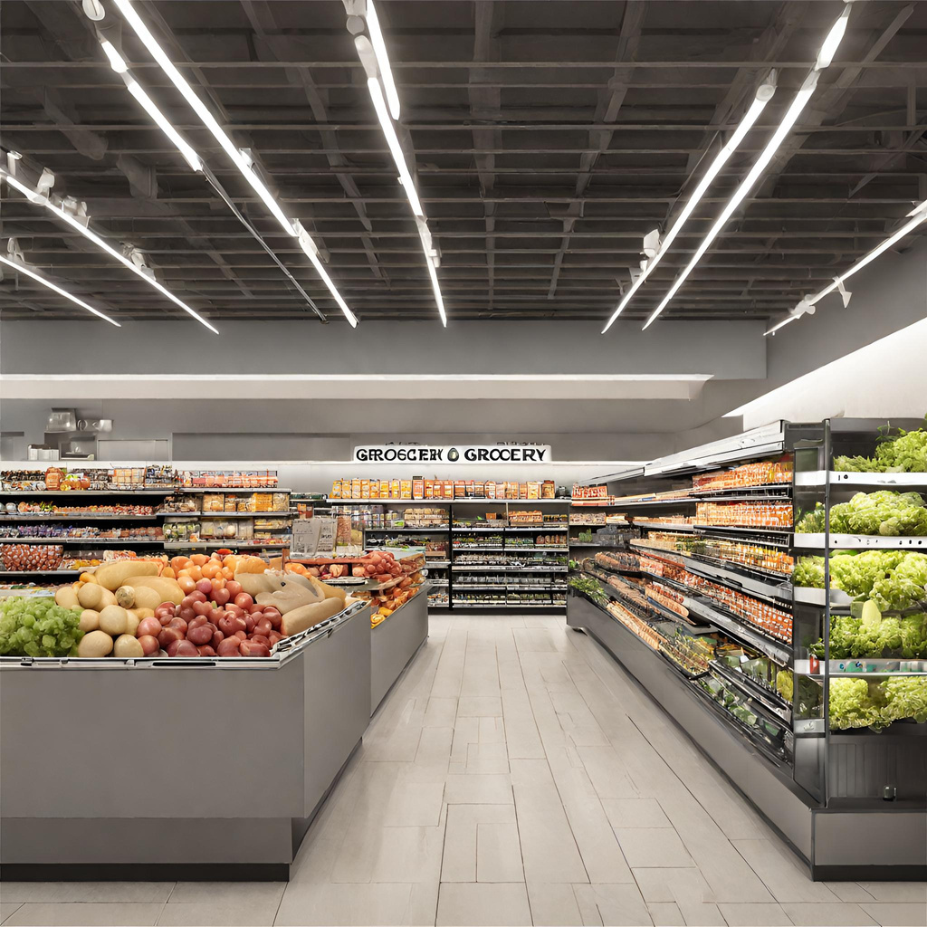
Our project introduces an innovative Grocery System, combining cutting-edge technology with industry best practices to enhance the grocery shopping experience. With a focus on operational efficiency, customer satisfaction, and inventory optimization, our system aims to modernize the grocery retail sector. By embracing the trends in online and offline shopping, we empower customers and store owners alike, creating a more sustainable and profitable grocery ecosystem.
Application For Grocery Delivery
▪
LMS Username
Name
Batch
AKSHAYA G
RAJASURIYA M
ARUN S

Slide 3
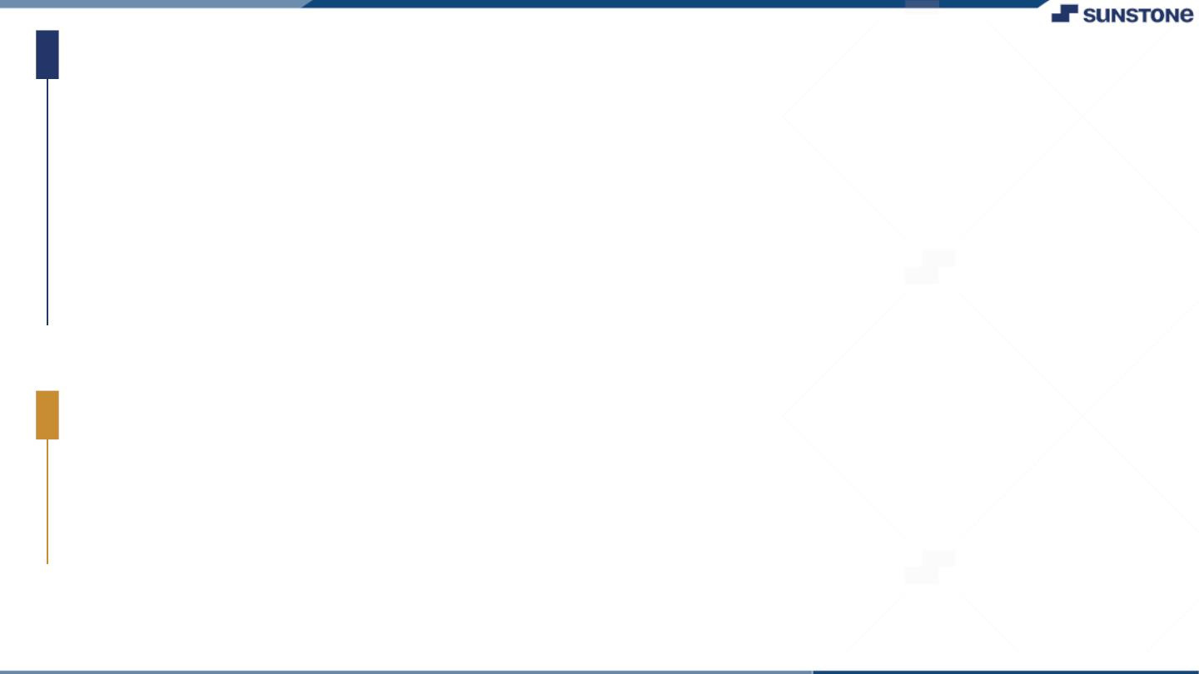
TASK - 1
Merits
1. Grocery apps offer the convenience of shopping from home, saving customers time and effort.
2. Users can access a broad range of products, including specialty items, enhancing their shopping experience.
3. Apps can tailor recommendations and discounts to individual preferences, creating a personalized shopping experience.
4. Grocery apps often provide various delivery choices, including same-day or scheduled deliveries, accommodating diverse customer needs.
5. Retailers can gather valuable data on customer behavior, helping them make informed decisions and improve their services.
Project Goals
Project goal for grocery application development involve creating a user-centric platform that prioritizes convenience and ease of use for online shopping. This platform should feature an efficient ordering system, providing customers with a streamlined process for selecting and purchasing items. Reliable and timely delivery services must be established to build trust and meet customer expectations.

Slide 4
Step-Wise Description
1. Initiation : Define objectives, scope, and form a team.
2. Requirements : Gather input from customers and store owners.
3. Design & Development : Create the system, develop features, and test.
4. Deployment & Feedback : Roll out gradually, gather user input.
5. Marketing, Maintenance & Growth : Promote, maintain, and explore expansion.
Summary of your task
This project introduces an advanced Grocery System, optimizing the grocery shopping experience.
It combines technology with industry expertise, emphasizing operational efficiency, customer satisfaction,
and inventory management. The project covers key stages, from requirement gathering to design, development,
and deployment, followed by marketing and maintenance.Ultimately, it aims to revolutionize grocery shopping, benefitting both customers and store owners while accommodating industry changes.

Slide 5
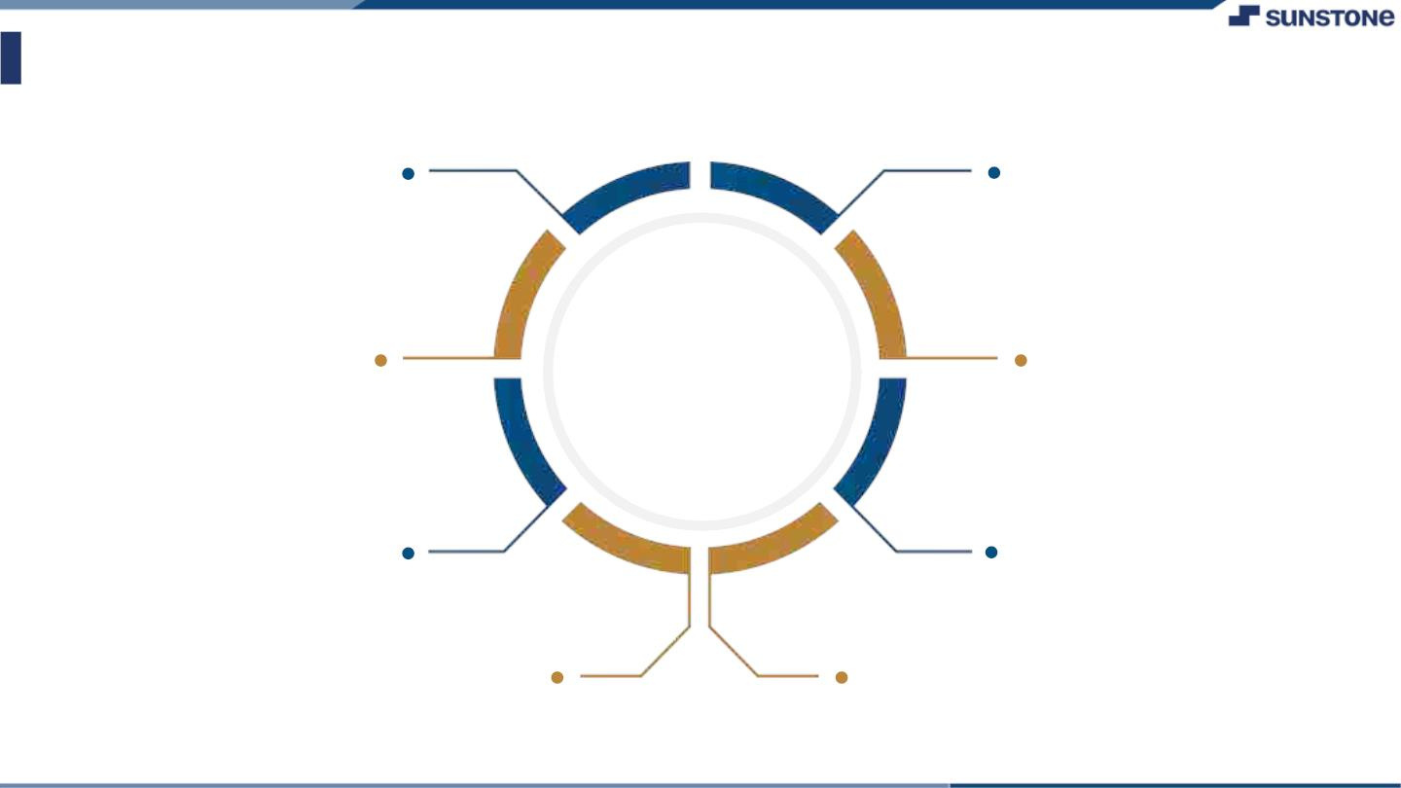
Assessment Parameter
Gather requirements for the
project
add Readme.md file with
description of the project
Prepare database design
schemas
Check-List
Commit all changes with"first
commit"
Get your initial project
Structure ready
create a repository on github
realted to project
Initiate a git repository
Push your changes to github

Slide 6
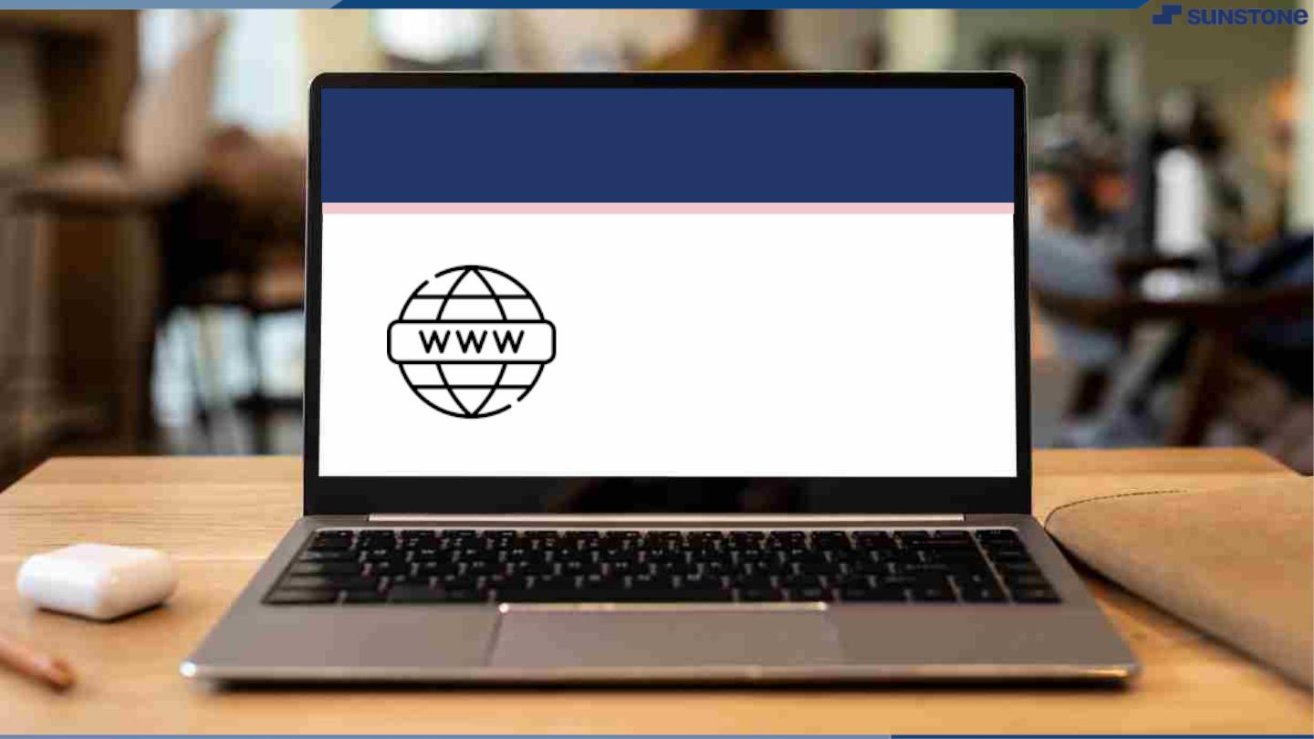
Submission Github
https://github.com/Suryao3/nm_fullstackjava.git

Slide 7


